Slide 1


Create React App GIT flow

Slide 2

Agenda
Advantages of React App
Considerations
How to start working with Create React App without having unrelated histories, or force pushing to the remote.
Link an already started Create React App to a Remote Repository that doesn’t have any commit in common

Slide 3
Create React App
Advantages of using React App:
Single page Application
Environment already set up
One command to build: npm run build // yarn build
Not only React: Uses Babel and Webpack under the hood (yet you don’t need to configure anything), ESLint helps you find problems too.
Template for Typescript
Packed with Jest for unit testing.

Slide 4
Create React App
What you don’t get out of the box and you might need to install as a dependency if you want to use:
Any framework/library for styling: Bootstrap, Material UI
A router: React Router
Axios (for making requests, instead of the Fetch API)
A deployment server - to be configured according the platform.

Slide 5
Solving problems with Initialized repo
The Problem:
When you have an initialized repo on a remote, the history of that git project might conflict with create-react-app’s one.
Create-react-app runs git init upon initialization. If we are working on a folder that already has run git init we will encounter problems.
The Solution:
We will clone the remote first, create react app in a nested folder so the .git folder from the remote doesn’t conflict with create-react-app’s one, then move the files from react app to the proper place and commit.

Slide 6
Solving problems with Initialized repo
Before we start:
DON’T PUSH FORCE!
IT WILL CLOSE THE FEEDBACK BRANCH
If for any reason you have unrelated histories, the proper flow to fix it is:
Git pull --allow-unrelated-histories
Solve conflicts
Commit
Git push

Slide 7
Solving problems with Initialized repo
How to start working with Create React App without having unrelated histories, or force pushing to the remote.

Slide 8
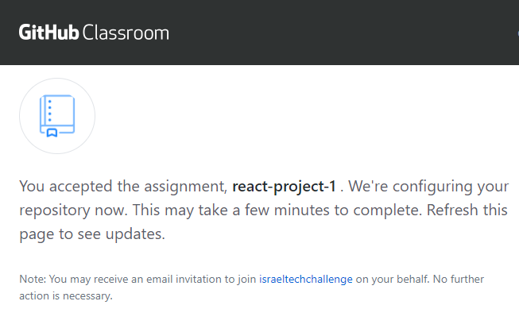
Solving problems with Initialized repo
First, let’s accept the assignment and open it on a browser:

Slide 9
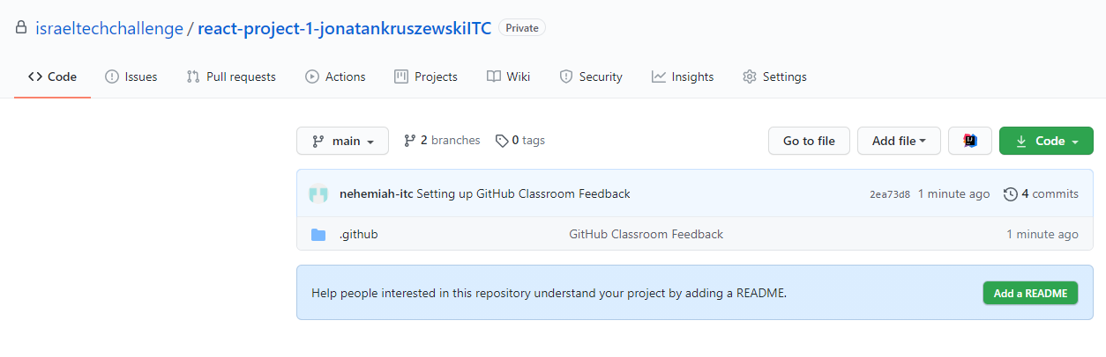
Solving problems with Initialized repo
Once ready, navigate to your project:

Slide 10
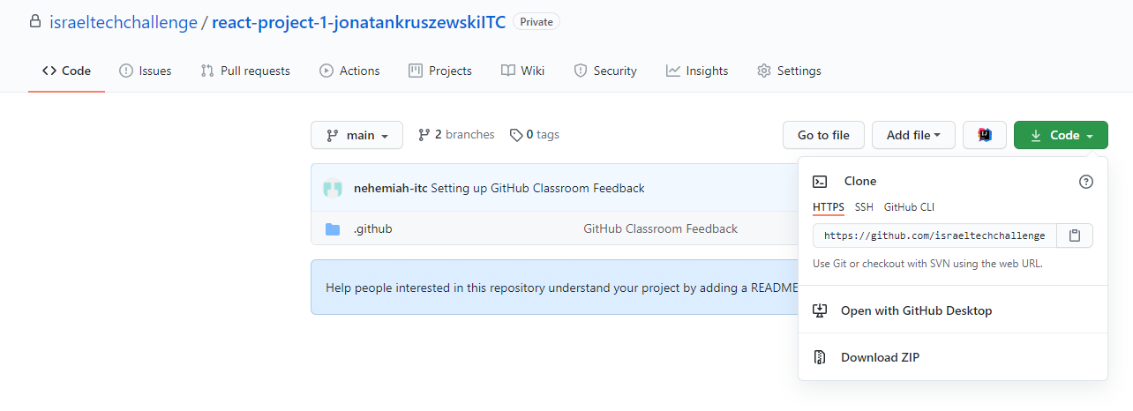
Solving problems with Initialized repo
Let’s grab the link to clone it. Remember to use HTTPS / SSH according to your configuration. In my case,

Slide 11
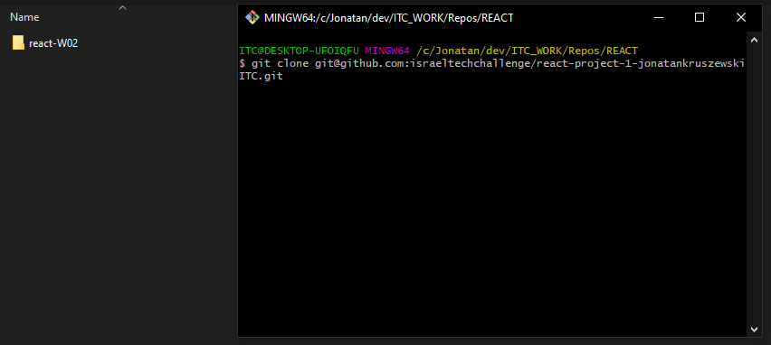
Solving problems with Initialized repo
Navigate to the location where you want to clone it. You can use ‘Open a new terminal here’ or ‘Git Bash here’ from the contextual menu or any other way of you preference, and run git clone <url>

Slide 12
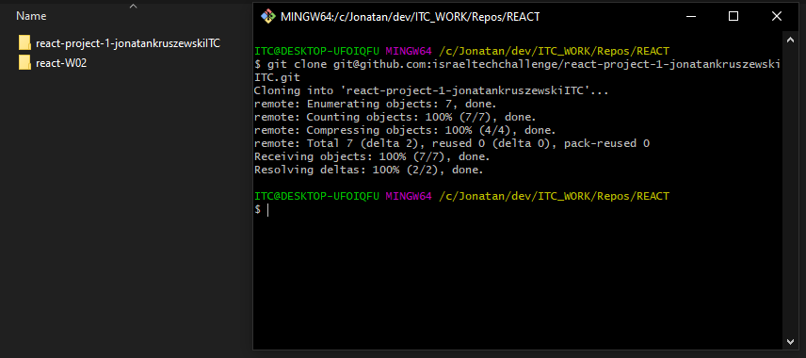
Solving problems with Initialized repo
Afterwards cloning, should look something like this:

Slide 13
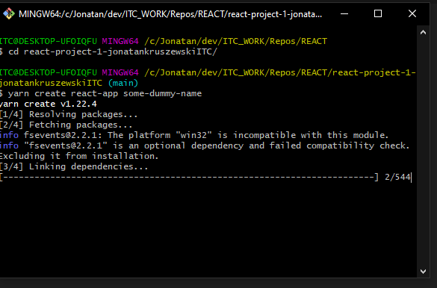
Solving problems with Initialized repo
cd into it and run the create-react-app command:
yarn create react-app <dummy-name>
The name actually doesn’t mind since we are going to move the files created from create-react-app from the nested folder to the cloned one.
Remember that the app name can’t have spaces or capital letters.

Slide 14
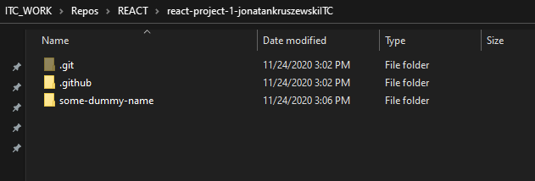
Solving problems with Initialized repo
At this point the repository should look something like this:
We will cut the files from some-dummy-name and place them on the root folder.

Slide 15
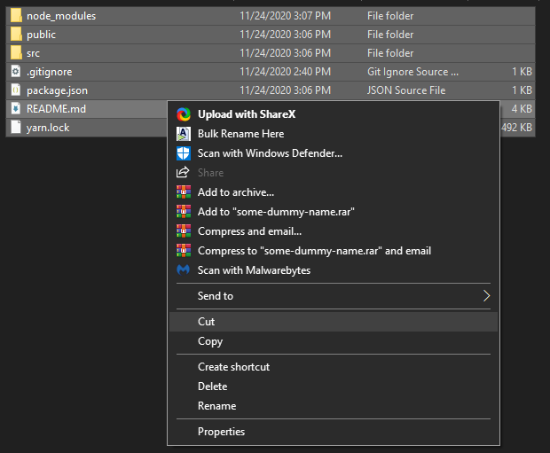
Solving problems with Initialized repo
Inside the folder created from create-react-app, let’s cut this files:

Slide 16
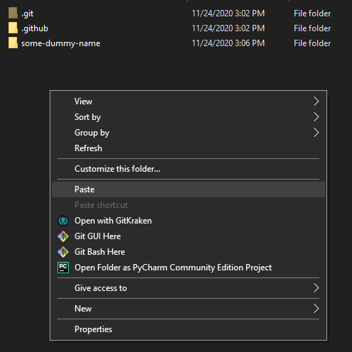
Solving problems with Initialized repo
Navigate to the root folder, paste the files, and delete the some-dummy-name folder:

Slide 17
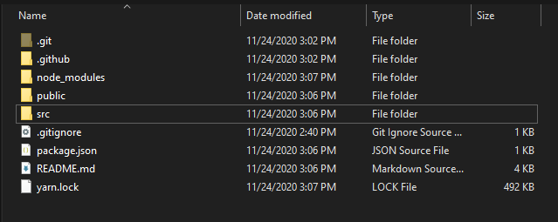
Solving problems with Initialized repo
At this point, your root folder should look something like this:
At this point you are good to commit without any trouble.

Slide 18
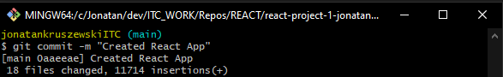
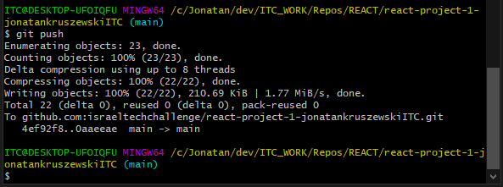
Solving problems with Initialized repo
git add . && git commit:
git push:

Slide 19
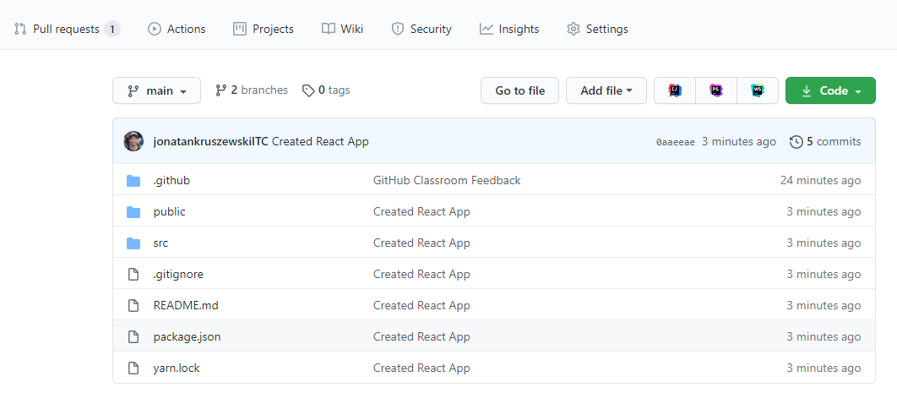
Solving problems with Initialized repo
On the remote you should see reflected the new changes:

Slide 20
Solving problems with Initialized repo
Link an already started Create React App to a Remote Repository that doesn’t have any commit in common

Slide 21
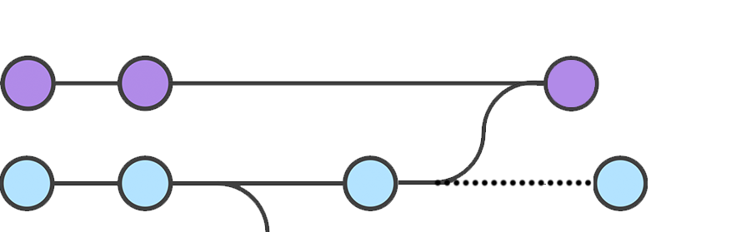
Solving problems with Initialized repo
If you have started working in your project, and you need to link it to a remote, chances are that your local project has a different history line than the remote’s:
git pull --allow-unrelated-histories origin main
local
F1A
F1B
F1C
M1
M2
M3
M4
remote
Since local and remote don’t have any commit in common before F1C, in order to be able to pull from the remote, first you are going to need to --allow-unrelated-histories. That flag on git pull will allow to bring the commits from the remote. You will need to solve conflicts, commit again, and only afterwards you will be allowed to push back to the remote.

Slide 22
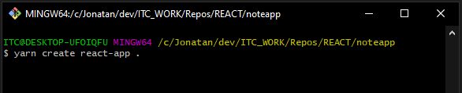
Solving problems with Initialized repo
Let’s create the React App:
In a folder that doesn’t contain capital letter or spaces let’s run:
yarn create react-app .
The . means ‘Create the app here’. If desired, you can pass a name instead, and it will create a nested folder on that location with your app. In this case, it is not desired.
Also, in order to work on the current folder, the current folder mustn’t have any capital letter or spaces.

Slide 23
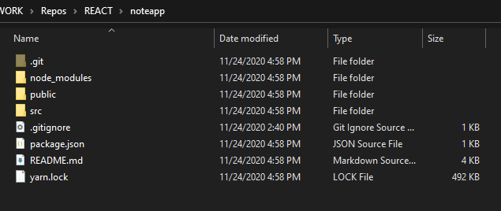
Solving problems with Initialized repo
Create React App delivers the following:

Slide 24
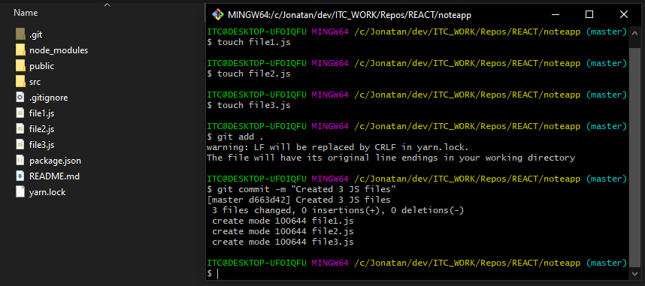
Solving problems with Initialized repo
Let’s add some changes. In this case, create some files, and commit them.

Slide 25
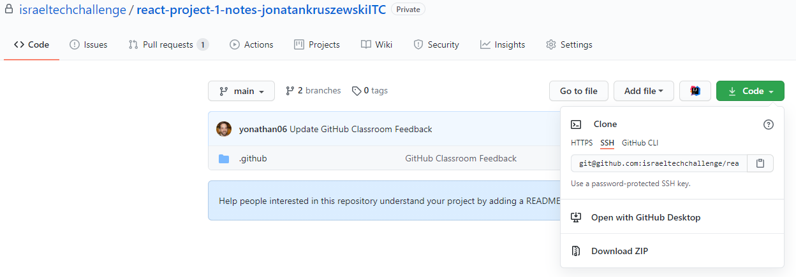
Solving problems with Initialized repo
Now, let’s grab the link from our project in the remote. Remember to use the proper method! SSH / HTTPS.

Slide 26
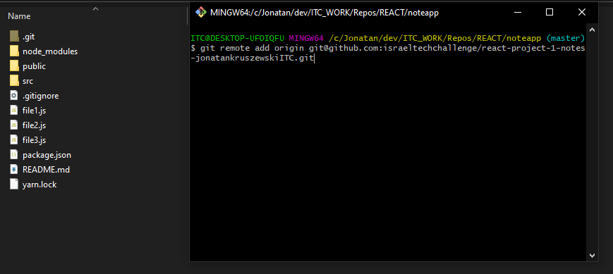
Solving problems with Initialized repo
Back in the terminal, at the project location:
git remote add origin <url>

Slide 27
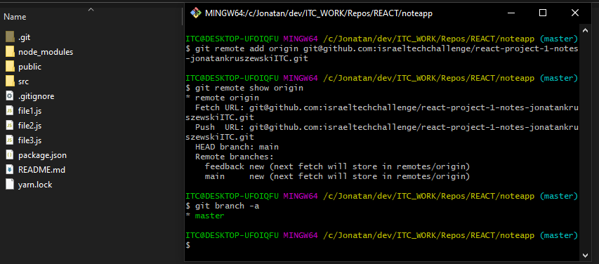
Solving problems with Initialized repo
Let’s run some commands to understand what is the situation:
git remote show origin // to see the branches names
git branch -a // to see our local branches.
We will have to rename the local branch master to main.
We will need to set it to track remote/main

Slide 28
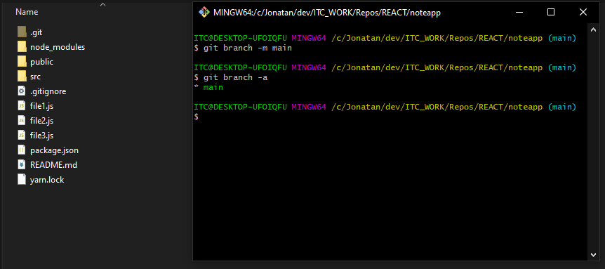
Solving problems with Initialized repo
Let’s rename the local branch:
git branch -M main // renaming the master to main
git branch -a // to see our local branches.
Now it is updated

Slide 29
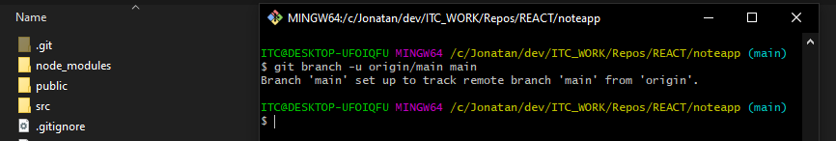
Solving problems with Initialized repo
Let’s pair this local main branch with the remote’s:
git branch -u origin/main main
If you get an error where it says: “The requested upstream branch ‘origin/main’ does not exist” please do:
git fetch --all
And keep working from there.

Slide 30
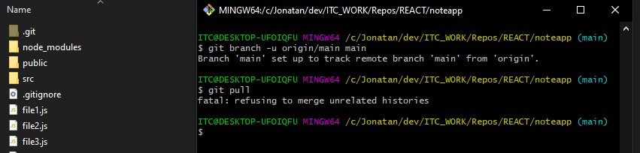
Solving problems with Initialized repo
Let’s try to pull.
git pull
We won’t be able…. Why? The histories are unrelated!
No commits in common between the work from the remote and the local work
No need to pass the remote name and branch because it has been set with the -u on the previous slide.

Slide 31
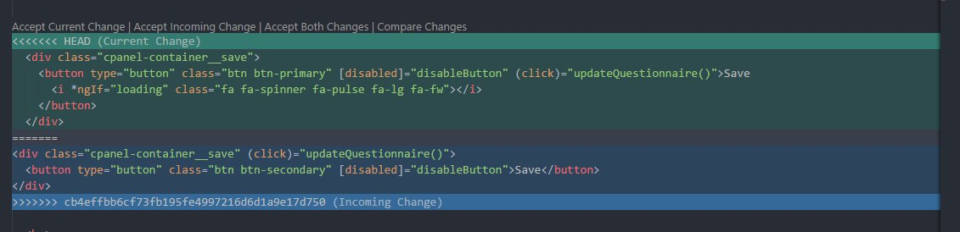
Solving problems with Initialized repo
How to solve it?
We will need to perform a pull with a special flag:
git pull --allow-unrelated-histories.
Some files might have conflicts too solve. You can solve them using the VSC integrated tool. Accept the incoming / current changes properly, and when finished stage them (git add) and commit.

Slide 32
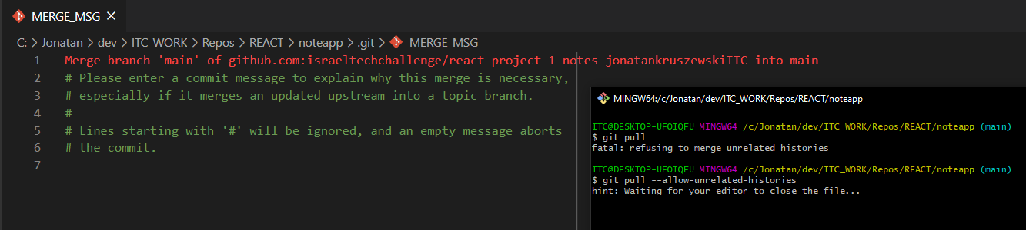
Solving problems with Initialized repo
How to solve it?
We will need to perform a pull with a special flag:
git pull --allow-unrelated-histories.
The editor might open. Close it when you finished editing the commit name

Slide 33
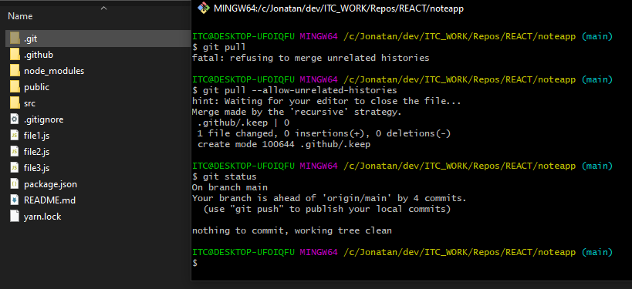
Solving problems with Initialized repo
Afterwards we pulled, we might see something like the following:

Slide 34
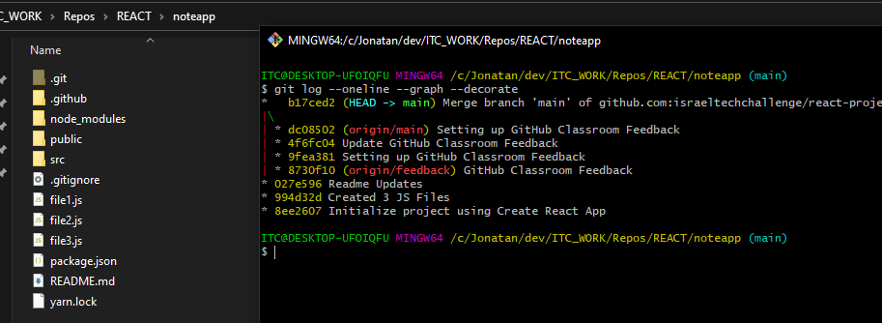
Solving problems with Initialized repo
Let’s give a look to the history using git log:
Pay attention to the graph that git log --graph --oneline --decorate shows. It shows 2 branches that merged on the commit b17ced2. This commit has 2 ancestors from 2 branches. From now on, we can push our work.

Slide 35
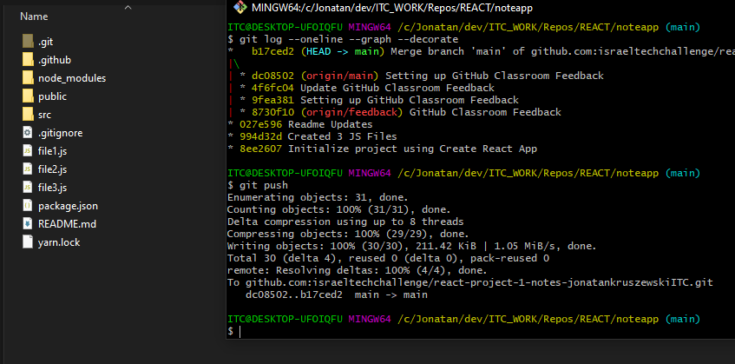
Solving problems with Initialized repo
Since the histories have been merged, we will be able to push:
That’s it 😎

